Slide 1
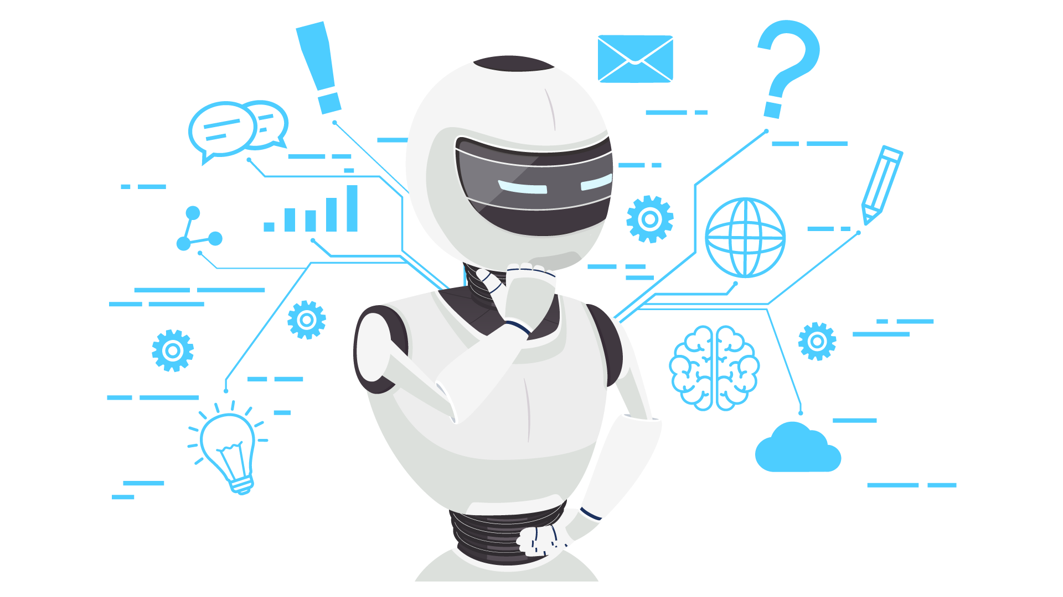








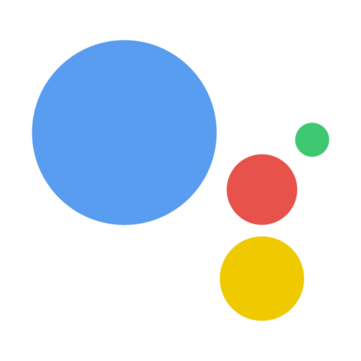







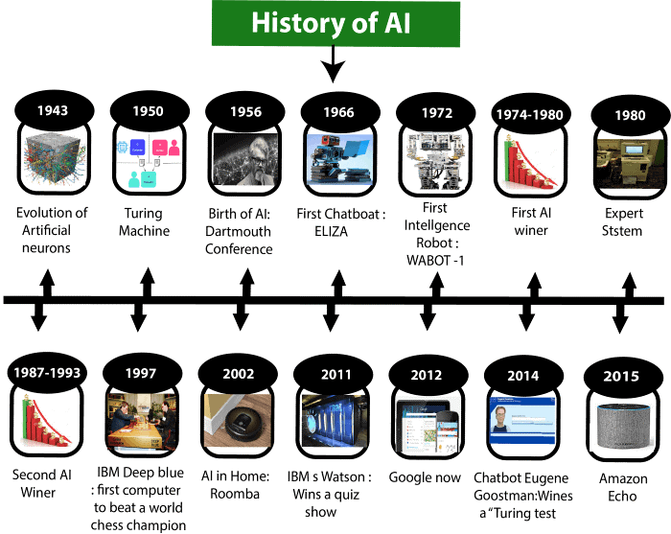
AI APPS
A simulation of human intelligence
processes by machines, especially
computer systems.
Who uses AI apps?
Transportation
Entertainment
Users
Healthcare
Sports
Manufacturing
What are AI apps?
Siri
Cortana
Google Assistant
Top AI apps used
What are some of the notable differences between the various AIs you’re exploring in terms of the interactions you have with them, their “personalities,” levels of sophistication etc.?
Overall the AI apps, I have used Siri more often overall apps. And maybe due to gender, I use the male Siri voice assistant. I have used Google Assistant too, and in terms of sense of humor I would say google assistant is better. I asked asking both apps with:
“What is love?”. Siri will give you a result of safari searched result. On the other hand,, google assistant will actually search and read it for you. Additionally, if you ask both if they can be your lover, Siri will answer you seriously that the AI can’t be your lover and can only be a virtual assistant. But google assistant will say yes and would tell you cheesy stuffs. To sum up, Siri is more of a serious one than google assistant.
Create new jobs
Why AI is important?
Revolutionize agriculture
We’ve seen technology skyrocketed, it has made so much life easier. In the present, we now have AI’s that could tell us the task to be done for the day. Even AI’s to turn on a music for you.
Improve healthcare
AI systems have the ability to adopt and learn as they make decisions. They are just like humans though they lack emotions. Basically, AI’s only become bias is our responsibility because we are the one’s that’s feeding them data.
When are AI’s created?
December 1955 Herbert Simon and Allen Newell develop the Logic Theorist, the first artificial intelligence program, which eventually would prove 38 of the first 52 theorems in Whitehead and Russell's Principia Mathematica.
Do these AIs have a discernible identity in terms of, for example, gender, class, culture or ethnicity? Why are they designed this way?
AI’s are just voices, so you can’t see any gender or classes with the eyes. But depending on the AI’s voice, you can tell if it is a girl or a boy. Ethnicity and culture will depend on the AI’s accent. They are design this way to somehow adjust to human needs.
AI doesn't have to be evil to destroy humanity – if AI has a goal and humanity just happens to come in the way, I will destroy humanity as a matter of course without even thinking about it, no hard feelings
-Elon Musk

